Slide 1
Unit - II
Project Planning

Slide 2
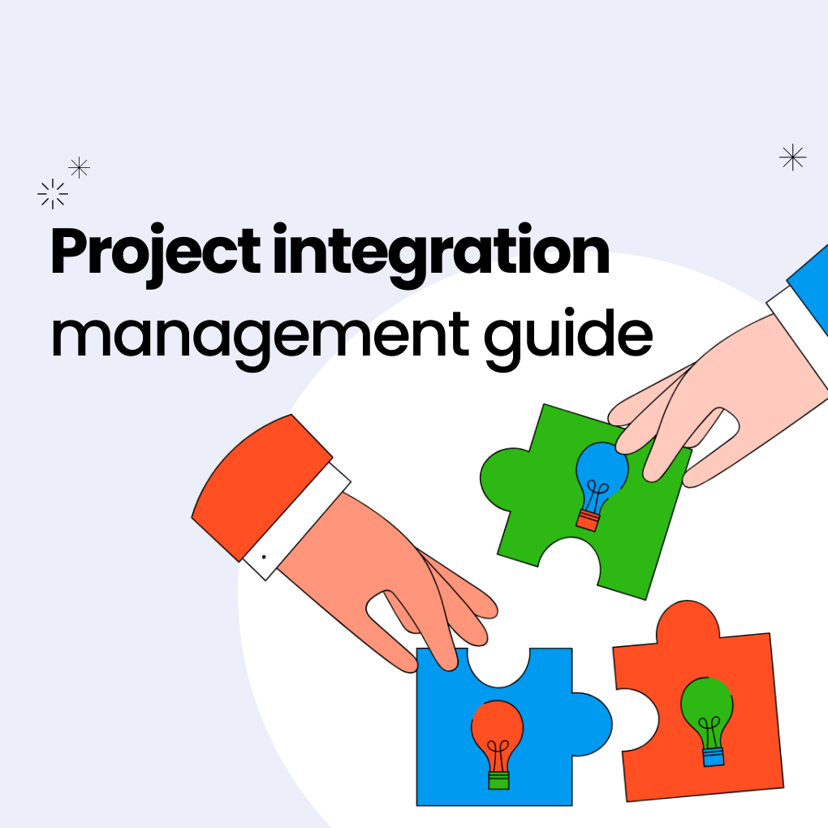
Project integration Management
Project integration management helps coordinate all the various parts of a project, so members of different teams follow one overall plan.
It keeps projects running smoothly and efficiently.
The project manager is responsible for integration management.
They ensure that project tasks and connected workflows are united.
Efficient project integration management is crucial for accurate project execution.

Slide 3
Benefits of project integration management.
Achieving project integration of teams and processes can be challenging. However, there are several key benefits for the progression of your projects.
Increased accountability from team members: Aligning project goals means team members should be 100% sure of their responsibilities and know the importance of managing each responsibility. As team members take on more responsibility, communication becomes less cluttered and more focused.
Increasing efficiency: Integration management means reviewing all project teams and analyzing where efficiency can be improved.
Clearly defined roles with no surprises: Once a project manager fully fleshes out the strategy, there should be no initial margin for error. Each team will be aware of its main aims and objectives and, therefore, which team is responsible for delivering each part.

Slide 4
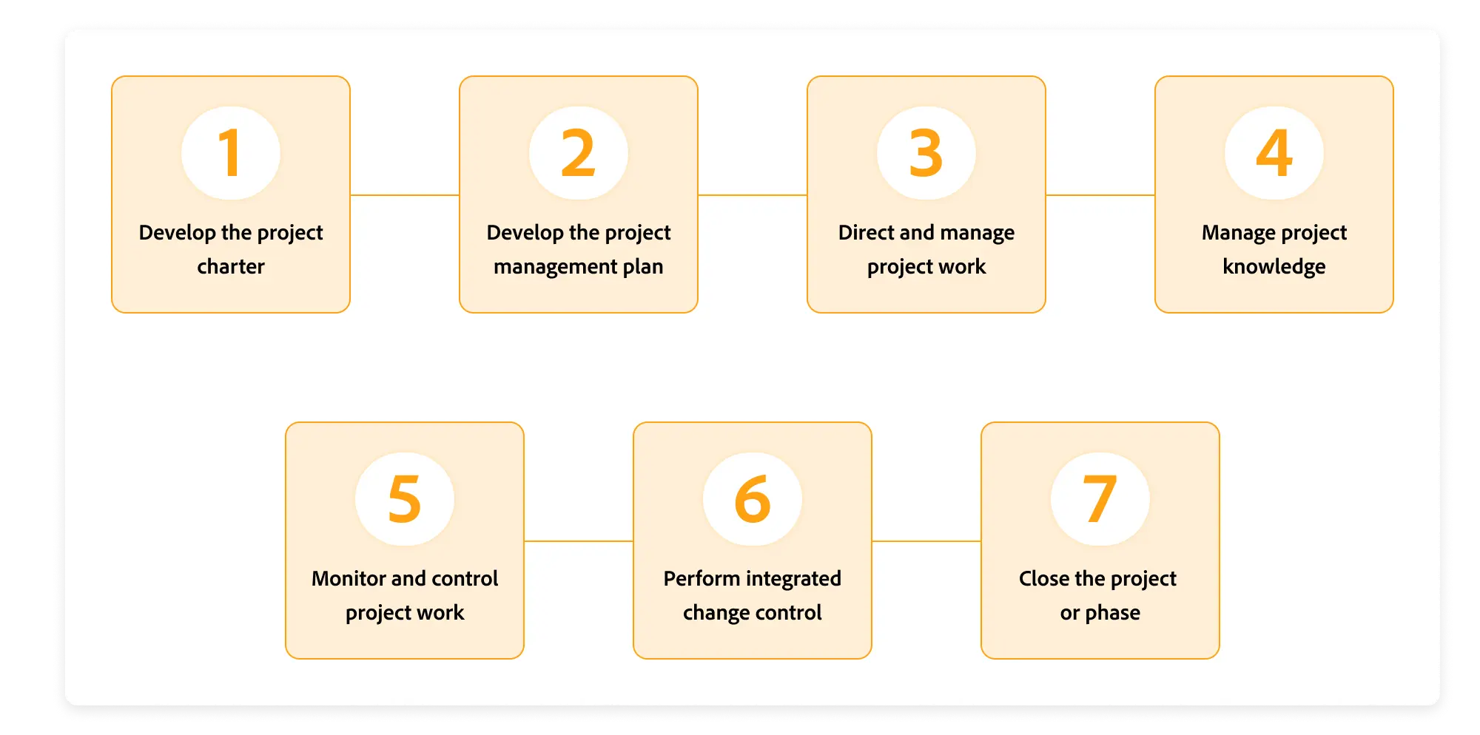
The project integration management process.
Understanding the systems, workflows, and methodologies all team members use is essential before implementing project integration management processes.

Slide 5
Example Project: Online College Admission System
1 Develop Project Charter
What happens?
The project is formally approved.
Example:
College management decides to develop an Online Admission System.
The Project Charter includes:
Objective: Online admission for students
Budget: 8 lakhs
Duration: 6 months
Project Manager: Assigned officially
Without this step, the project cannot officially start.

Slide 6
2 Develop Project Management Plan
What happens?
All individual plans are combined into one integrated plan.
Example:
The project manager prepares and integrates:
Scope plan (modules: registration, payment, merit list)
Schedule plan (timeline for each module)
Cost plan (development, testing, hosting)
Risk plan (server failure, security risk)
➡All these are merged into one Project Management Plan.
This is the core of integration management.

Slide 7
3 Direct and Manage Project Work
What happens?
The plan is executed and work is performed.
Example:
Developers code the admission portal
Testers test payment and login modules
Project manager coordinates team and resources
➡ Ensures work is done as per the integrated plan.

Slide 8
4Monitor and Control Project Work
What happens?
Actual progress is compared with planned progress.
Example:
Planned: Registration module completed in 3 weeks
Actual: Takes 4 weeks
The project manager:
Identifies delay
Takes corrective action (extra resources / revised schedule)
Keeps the project on track.

Slide 9
5 Perform Integrated Change Control (Very Important for Exams)
What happens?
All change requests are reviewed and approved/rejected formally.
Example:
Client requests online document upload feature.
Project manager checks:
Impact on cost
Impact on schedule
Impact on scope
➡ Change Control Board (CCB) approves the change.
Prevents scope creep.

Slide 10
6 Close Project or Phase
What happens?
Formal completion and handover.
Example:
System delivered and accepted by college
Documentation submitted
Final report prepared
Team released
Project is officially closed.

Slide 11
Flow
Project Charter
↓
Project Management
↓
Execute Work
↓
Monitor & Control
↓
Change Control
↓
Project Closure

